Slide 1
Alternate Assessment Participation
[State's name] Guidance on Who Should Participate in [state's name for alternate assessment]
Notes:
Possible Points to Make:
This presentation is designed for school and district administrators, which means that we have tried to keep it short and instead of making it longer, provide places to go for additional information
It addresses any misunderstandings that you or others might have about which students with disabilities should participate in the [state's name for alternate assessment]
It provides ideas for communicating with staff and parents about the [state's name for alternate assessment]

Slide 2
Presentation Objectives
Purpose of [state name for alternate assessment]
Implications for a student who takes the [state name for alternate assessment]
Talking with parents about the [state name for alternate assessment]
Supporting decisions about which students should participate in the [state name for alternate assessment]
Notes:
Possible Points to Make:
The objectives for this presentation are listed here
One objective is to review the purpose of the [state's name for alternate assessment], including how the results of the [state's name for alternate assessment] are used
Another objective is to highlight the implications of a student taking the [state's name for alternate assessment], specifically the potential effects on those students taking the [state's name for alternate assessment]
Because of the importance of the IEP decision-making process in deciding who participates in the [state's name for alternate assessment], we will spend time identifying some strategies for talking with parents about the [state's name for alternate assessment] and what participation in that assessment means for their child
Finally, in this presentation we will review information on which students should participate in the [state's name for alternate assessment] and how to identify these students

Slide 3
Alternate Assessment Purpose
The [state name for alternate assessment] is one part of our state's assessment system for school-age children
The [state name for alternate assessment] is designed specifically for those students with "the most significant cognitive disabilities." It is based on alternate achievement standards, which means the performance expected is different.
Notes:
Possible Points to Make:
The [state's name for alternate assessment] is one part of our state's assessment system
The purpose of the [state's name for alternate assessment] is [modify the following as appropriate for your state] to provide students with the most significant cognitive disabilities with an assessment specifically designed for those students
The [state's name for alternate assessment] holds students who participate in it to different performance standards, which are referred to as "alternate academic achievement standards" - this is why you may see some information referring to the AA-AAAS (Alternate Assessment aligned to Alternate Academic Achievement Standards). The content standards are the same as those for all other students, but may be reduced in depth, breadth, and complexity.

Slide 4
Federal Law Requirements
The Every Student Succeeds Act (ESSA) provides funds for our state's elementary and secondary education system. We must adhere to ESSA requirements, including those about state and district assessments
ESSA placed a 1.0% state-level cap on participation in the [state's name for alternate assessment], by subject area, across all grades.
Notes:
Possible Points to Make:
It is important to talk about the role that federal education law plays in defining state, district, and school requirements in implementing the [state's name for alternate assessment]
The Elementary and Secondary Education Act (ESEA), which provides funds to states, districts, and schools was reauthorized by Congress in 2015 as the Every Student Succeeds Act (ESSA). To receive those funds, we are all required to adhere to ESSA requirements, including the requirement for all students to participate in state and district-wide assessments.
One of the new requirements included in ESSA is the state-level cap of 1.0% on the percentage of tested students in a subject area who participate in the [state's name for alternate assessment]. This is calculated by dividing the number of students participating in the [state's name for alternate assessment] in a subject area by the number of all students tested in that subject area

Slide 5
Implications for Districts
ESSA requires districts with more than 1.0% participation in the [state name for alternate assessment] in a subject area to provide to the state:
Assurance that IEP teams are adhering to the state's participation guidelines
Justification for the participation rate over 1.0%
Assurance that parents are informed about implications for their child of participation in the [state name for alternate assessment]
Notes:
Possible Points to Make:
ESSA specifically addresses the role of districts in the new participation requirements for the [state's name for alternate assessment]
Any district in which more than 1.0% of tested students participate or are expected to participate in the [state's name for alternate assessment] must provide to the state the items listed here - assurance that its IEP teams are adhering to the state participation guidelines; a justification, with data, for districts participation in the [state's name for alternate assessment] being over 1.0%; and assurance that parents of students in the district are informed about the implications for their child of participation in the [state's name for alternate assessment]
Next, more details are provided about that last point with regards to parents being informed about implications

Slide 6
Implications for Students
Short-term: Student's instruction is in less depth, breadth, and complexity than the instruction of other students
Long-term: Student may not meet the requirements for the state's graduation diploma
Longer-term: Student may not be eligible for some post-secondary training institutions, military service, or jobs
Notes:
Possible Points to Make:
This slide provides some of the possible implications for students of participation in the [state's name for alternate assessment], listed here by whether they are short-term, long-term, or longer-term
Short-term implications focus on the nature of instruction provided to students - for the [state's name for alternate assessment], students are instructed on our ELA, math, science, and other subject area standards presented in less depth, breadth, and complexity compared to the instruction provided to their peers. This necessarily means that they may not be instructed on some of the content that their peers are, which in turn will have potential long-term consequences.
Long-term implications include the possibility that a student may not meet our state's graduation requirements, or that a student may be delayed in making progress toward meeting those requirements [Provide explanation if this is an implication for your state]
Longer-term implications include the possibility that a student may not be eligible for some post-school opportunities, including admission to some post-secondary training institutions, military service, or jobs.

Slide 7
Which Students Should Participate?
Only those students with the "most significant cognitive disabilities"
Most of these students (but not all) have intellectual disabilities, autism, and multiple disabilities
Many of these students (but not all) were identified for special education services prior to entering kindergarten
The decision about which students should participate in [state's name for alternate assessment] is often very difficult.
Notes:
Possible Points to Make:
Now to clarify which students should participate in the [state's name for alternate assessment]
First, as stated in law and regulations, only those students who have the "most significant cognitive disabilities" should participate in the [state's name for alternate assessment]. But, what does "the most significant cognitive disabilities" really mean? We need to explore this in more depth because there is no special education category of "most significant cognitive disability"
One of the things that we know is that most of the students who do appropriately participate in the [state's name for alternate assessment] have the IDEA categorical labels of intellectual disabilities, autism, and multiple disabilities BUT it is critical to remember that not all of the students with these labels should be assigned to the [state's name for alternate assessment]
Another thing that we know is that many of the students who do appropriately participate in the [state's name for alternate assessment] come to kindergarten already having been identified for special education services to support their intellectual and adaptive behavior challenges. Of course, not all of these students should take the [state's name for alternate assessment]
As you can tell from what we know, the decision about which students should participate in [state's name for alternate assessment] is often a very difficult decision.

Slide 8
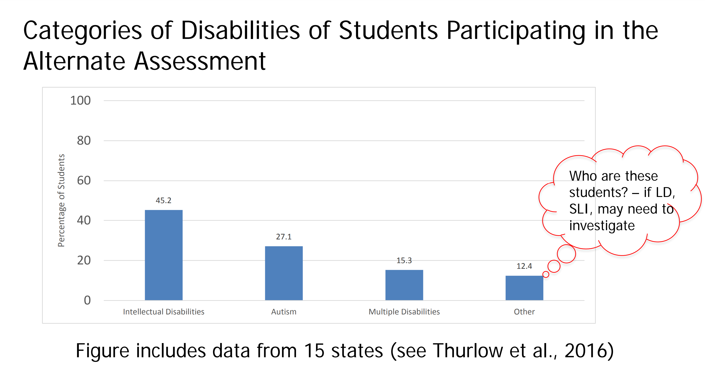
National and State Data
National data on
disability categories
Our state's data:
[Enter state data on categories, if available]
Slide from Thurlow & Lazarus (2017): http://nceo.umn.edu/docs/Presentations/1percentCap042717.pdf
Notes:
Possible Points to Make:
Data help us to understand who the students are who are participating in alternate assessments across states and who are participating in our [state's name for alternate assessment]
The national data, based here on 15 states, show the percentages in the three disability categories already mentioned - intellectual disabilities, autism, and multiple disabilities. The last bar in the chart reflects other disabilities, some of which are questionable, such as students with learning disabilities and speech-language impairments. Some students in other categories may be appropriately participating in the alternate assessment, such as students who are in the deaf-blind category who also have significant intellectual and adaptive functioning challenges.
In our state….[add available data]

Slide 9
State Guidelines Across the U.S.
Student's disability significantly affects intellectual functioning and adaptive behavior
Student requires extensive, direct, and individualized instruction and supports that are not temporary or transient in nature
Student uses substantially adapted materials and individualized methods of accessing materials
Student's instruction is based on alternate academic achievement standards
Notes:
Possible Points to Make:
This slide shows information about commonalities in state guidelines for deciding who should participate in the alternate assessment.
As showed in the slide, they are that (a) the disability significantly affect intellectual functioning and adaptive behavior; (b) the instruction of the student is extensive, direct, and individualized with supports provided in all subject areas, with similar supports provided at home; (c) educational and other materials for the student are adapted significantly and specific supports are provided to help the student access those materials; and (d) the student's instruction and performance area aligned to alternate academic achievement standards.
Some of the students do not yet have a communication system while others use alternative communication systems. Whether a student has a communication system does not determine which assessment the student should take

Slide 10
State Guidelines
[Insert primary points in your state's participation guidelines]
[Provide link(s) to guidelines and supporting materials on your state's guidelines]
Notes:
Possible Points to Make:
Our state has guidelines to help IEP teams determine who should participate in the [state's name for alternate assessment]
[Provide the primary points in your state guidelines]
[Provide links to your state resources]
[ADD additional slides, as needed, to show resources available on your website; include your state's definition of "students with the most significant cognitive disabilities" if appropriate]

Slide 11
Participation Decision-Making Process
Individualized Education Program (IEP) teams make the decision about which assessment a student takes
Parents and guardians are key to the decision
School professionals should not make decision without parent or guardian input
IEP teams need training and resources to help with making the participation decision
[Provide link to state's resources here]
Notes:
Possible Points to Make:
Just a reminder about the process for making the participation decision.
First, the IEP team must make the decision about which assessment a student takes. No administrator or single educator should make that decision.
Parents and guardians are to be informed decision makers about assessment participation during the IEP meeting. They should not be left out of the decision, even if they are not able to attend the meeting. [Provide additional information about your state's requirements, for example, whether a signature is required for the assessment participation decision]
Training is a critical part of helping IEP teams make appropriate decisions about participation in the alternate assessment. As an administrator, you should support training efforts for staff, and lead or participate in training efforts to the extent possible.

Slide 12
Communicating with
Parents and Guardians
Listen to them and respect their views!
Treat them as equal partners in the education of their child
Show up where they are (e.g., community events), partner with community organizations, and engage community liaisons
Use interpreters to bridge potential cultural and linguistic barriers
Notes:
Possible Points to Make:
There are many reasons for us to talk about communicating with parents and guardians. As noted, they are critical decision makers in the decision about which assessment their child takes because it may have life-long implications for their child
Among the challenges in engaging parents and guardians are that the information may seem overwhelming to parents and guardians or there may be a possible history of mutual distrust and uncomfortable communication between parents and guardians and school personnel
The points listed here are ones that you know, but are especially important to remember when talking to parents and guardians about participation in the [state's name for alternate assessment]

Slide 13
Helpful Resources
State Department Contact:
State Resources:
Other Resources:
1% Toolkit from the National Center on Educational Outcomes (NCEO):
https://nceo.info/Resources/tools
Notes:
[Add here state contact information and other state resources]
If appropriate, provide a link to the NCEO 1% Toolkit (shown on slide)

